Slide 1
Pen and Printers
Practical exam for
Professional Data Analysis
Submitted by: Rafael B. Bashan

Slide 2
Data Presentation
In this project, I analyze the sales performance of a new office stationery line using Emails, Calls, and "Email + Call." With 15,000 observations from our sales tracking system, I assess the effectiveness of each method based on sales data collected over the first six weeks post-launch. This analysis helps optimize our sales tactics in a digital marketplace.

Slide 3
Data Validation
To enhance product sales, I reviewed a dataset of 15,000 customers. Key steps included removing duplicates, addressing 1074 missing revenue values, and correcting mislabeled sales methods, reducing categories from five to three. I also removed outliers in the years_as_customer column, such as entries claiming 47 and 63 years, exceeding the store's 40-year history. After cleanup, the validated dataset now contains 13,926 rows across 8 columns, all verified as clean.

Slide 4
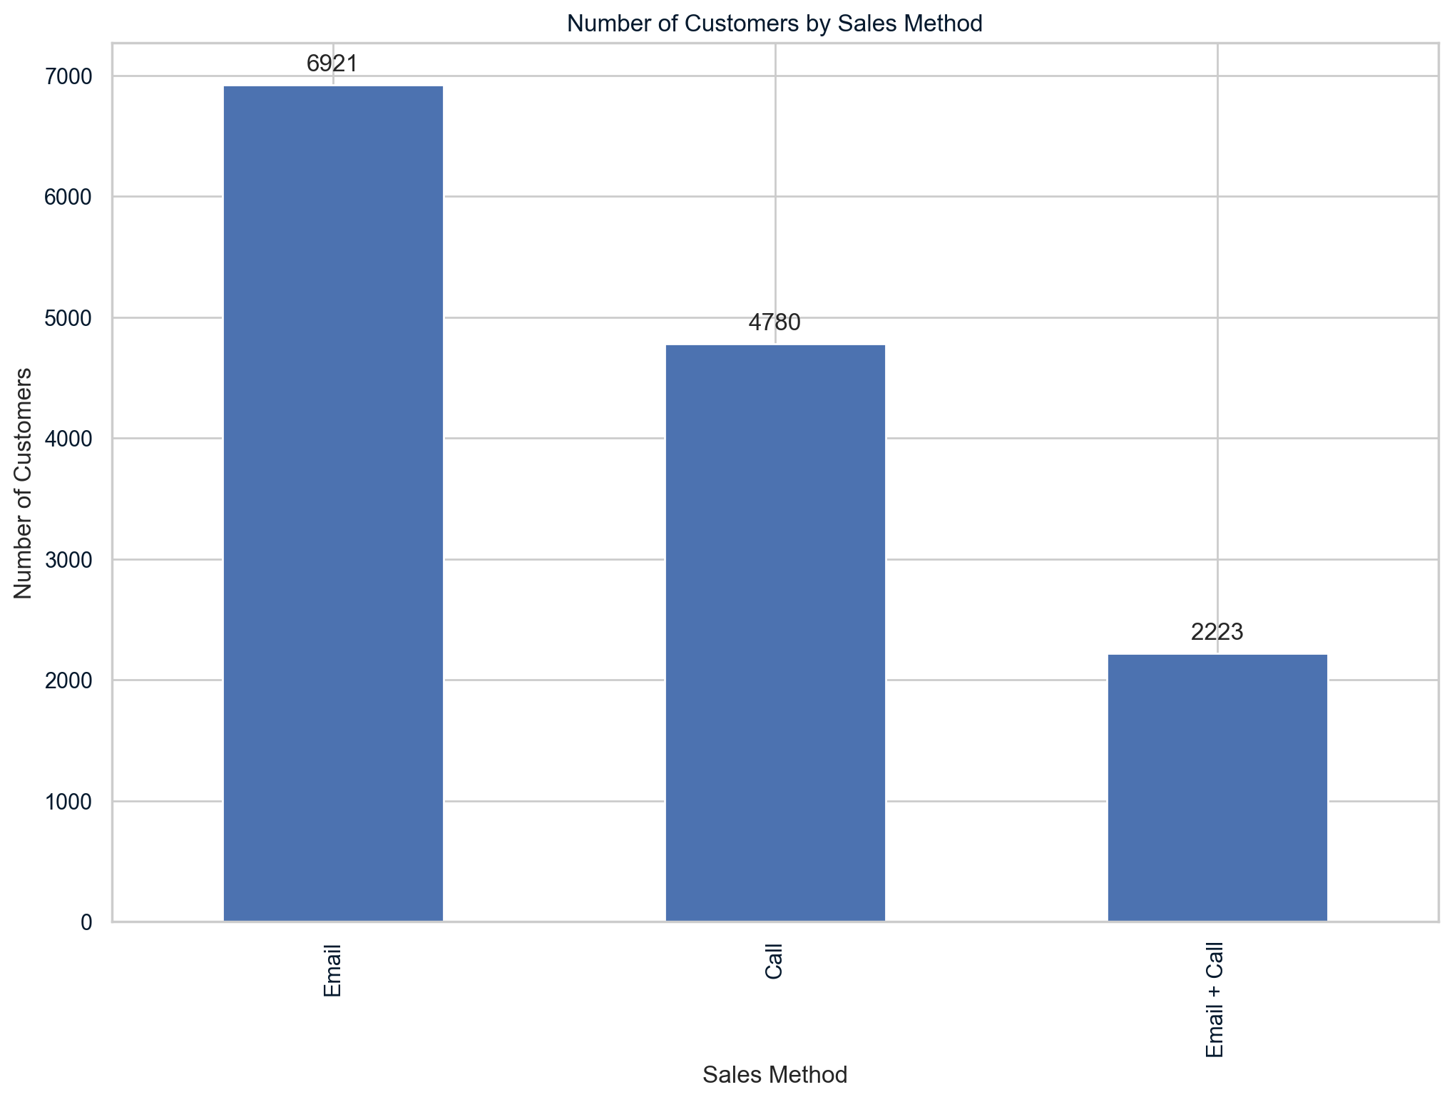
Exploratory Analysis
1. How many customers were there for each approach?
The bar chart shows that Email was the most successful sales method with 6,921 sales. The Call method followed with 4,780 sales, and the combined "Email + Call" method accounted for 2,223 sales. Notably, Email sales made up about 50% of the total sales.

Slide 5
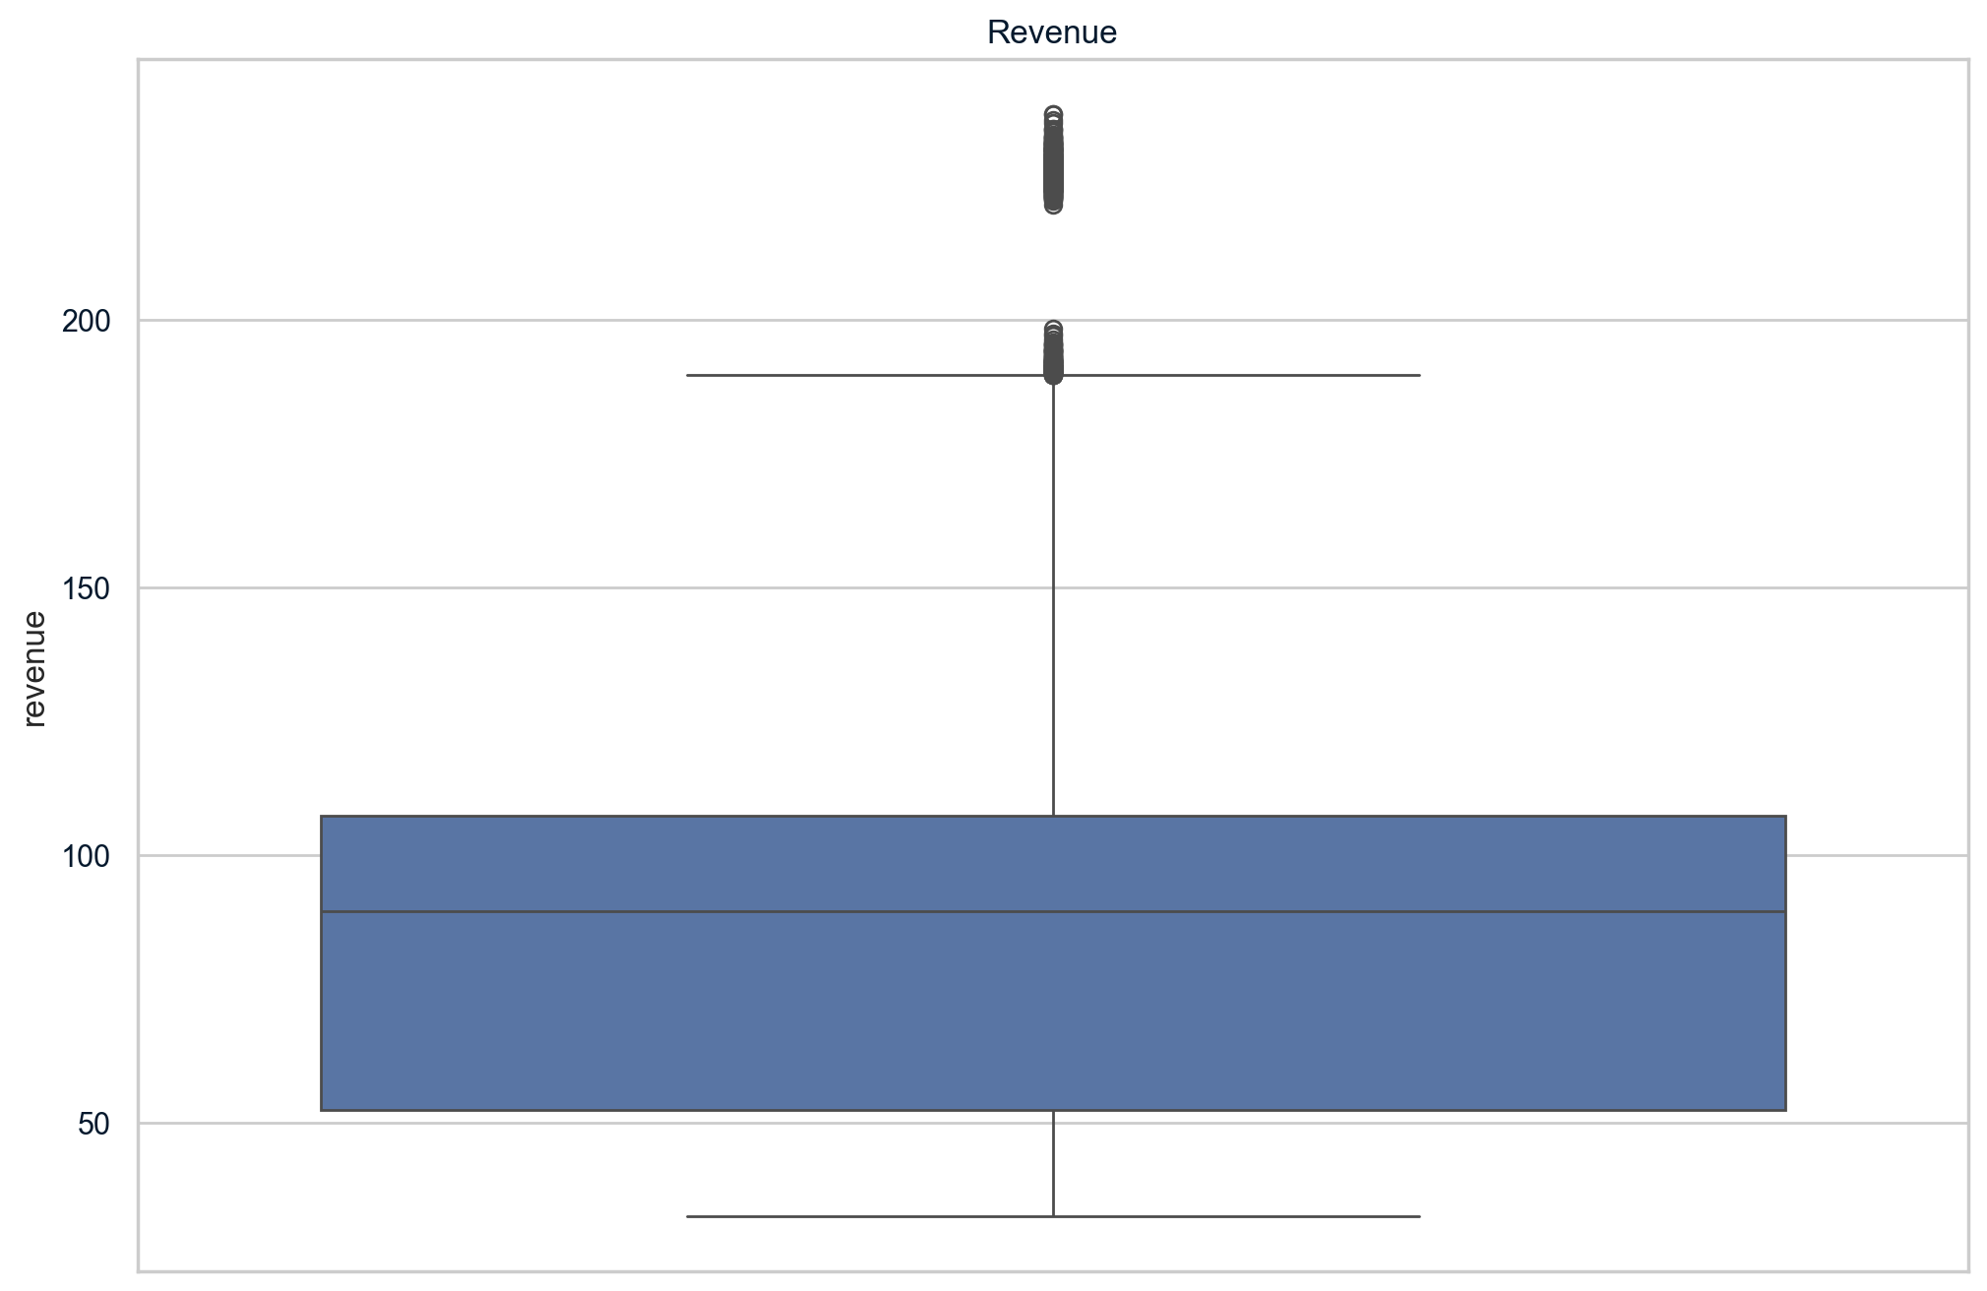
2.1 What does the spread of revenue look like overall?
The boxplot chart shows that the median revenue is just under 100. The interquartile range, representing the middle 50% of revenues per customer, is between 50 and 100. Additionally, values over 190 are considered outliers.

Slide 6
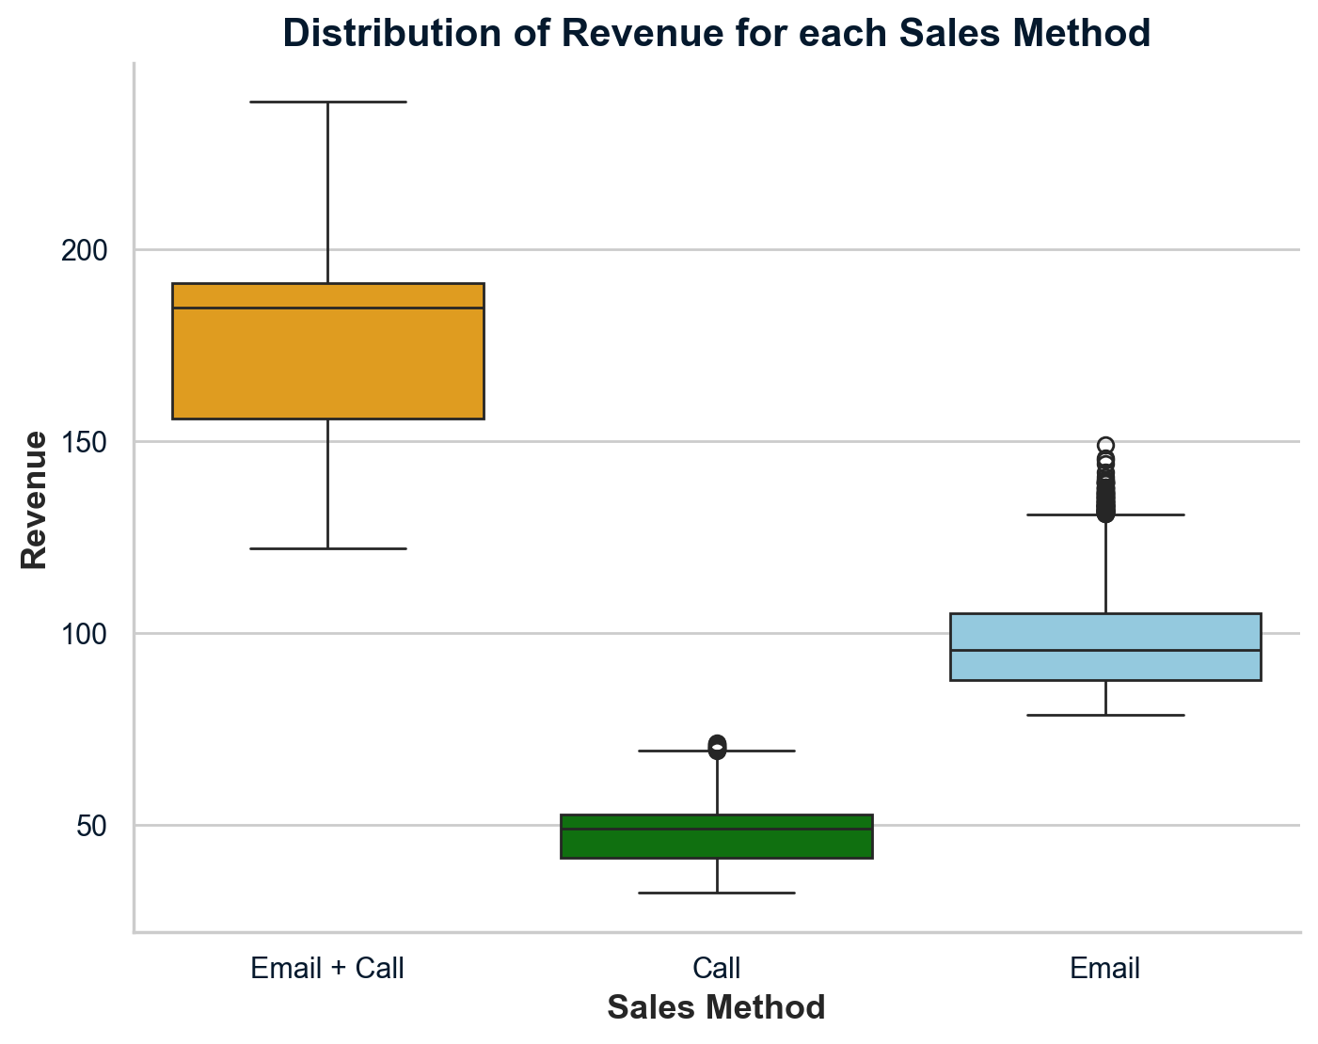
2.2 What does the spread of revenue look like for each sales method?
Revenue distribution by sales method shows distinct differences: the Email + Call method has the widest spread and the highest median at about $190. The Call method has a narrower spread with a median around $50, while the Email method, with a similar spread to the Call method, has a higher median near $90.

Slide 7
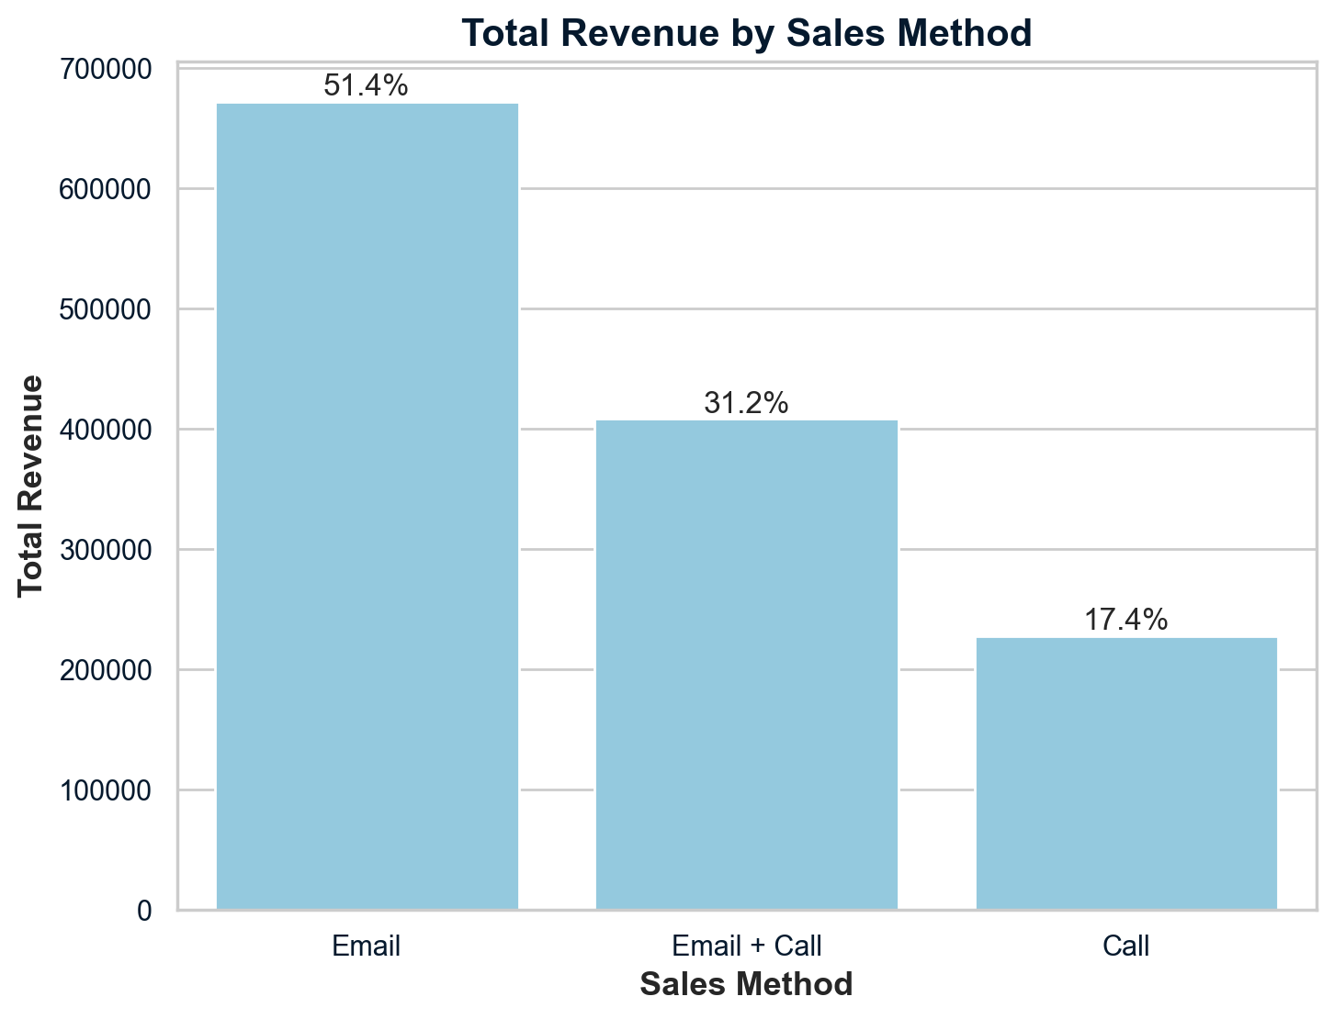
The chart at left shows that the Email sales method generated the most
revenue, accounting for approximately 51.4% of the total. Email + Call
contributed around 31.2%, while Calls produced the least, making up about
17.4% of total revenue.

Slide 8
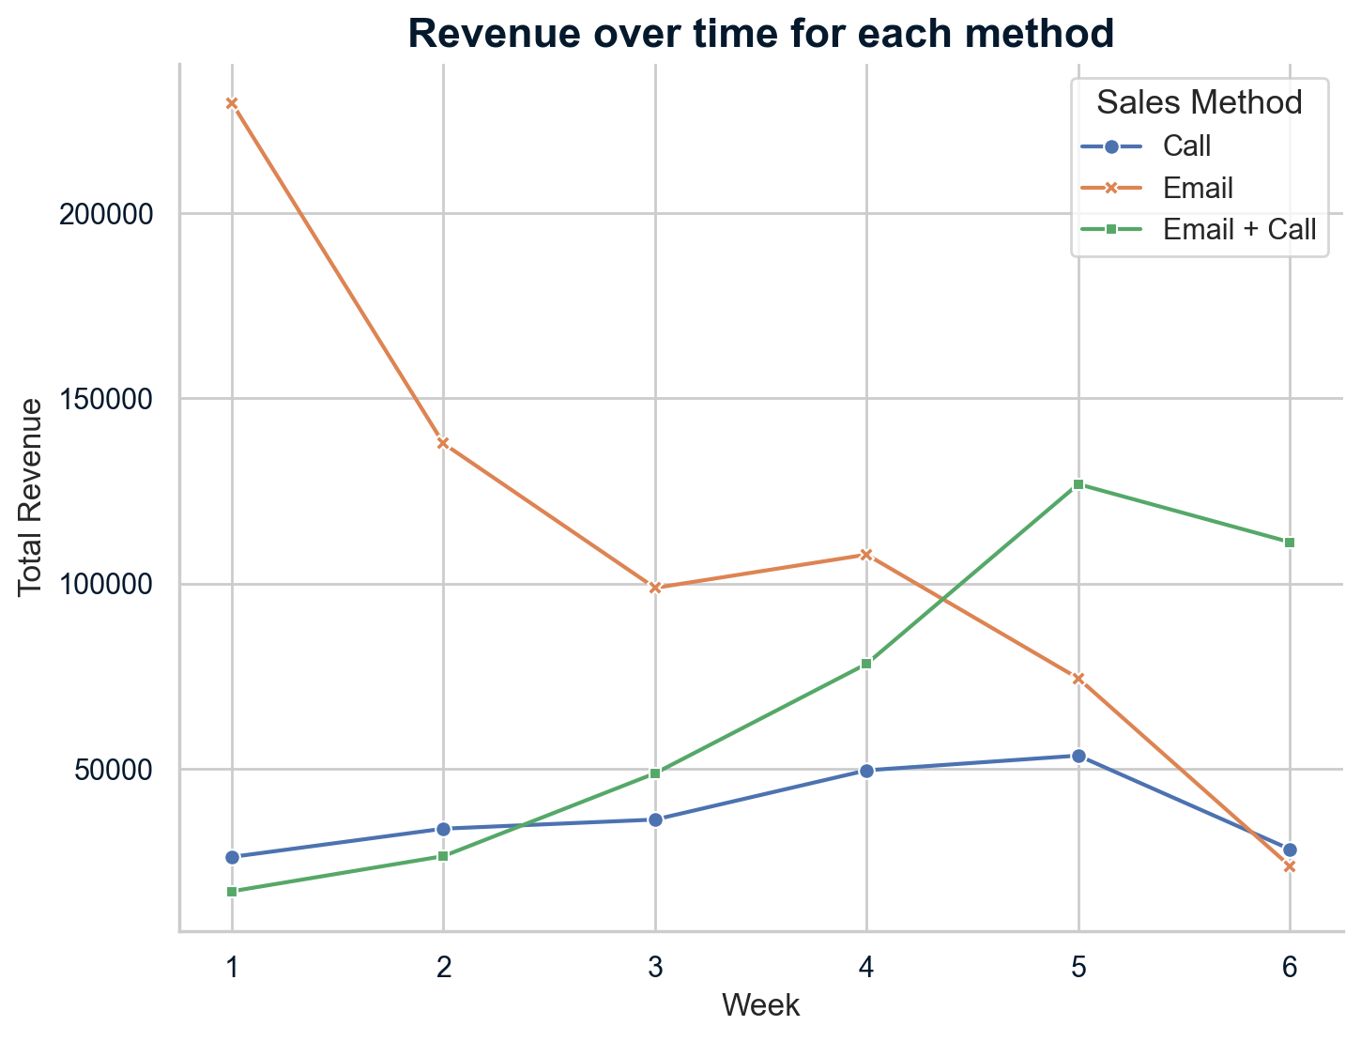
3. Was there any difference in revenue over time for each of the methods?
The line graph shows that Email sales peaked at about $230,000 in Week 1 but declined by over 58% to approximately $99,000 by Week 3. In contrast, the Email + Call method started lower but eventually surpassed the other methods, showing consistent growth and peaking in Week 6, indicating it as the most effective strategy. The Call-only method showed minimal revenue changes, suggesting that using Email alone or combined with Calls is more effective in engaging customers.

Slide 9
Recommendations
4. Based on the Data, which method would you recommend we continue to use?
The Call strategy yields the least favorable results with low ROI and a high time demand of about 30 minutes per interaction.
Integrating emails with calls could enhance the effectiveness of the standalone calling approach, as emails require minimal effort yet provide valuable product insights.
The Email + Call strategy is highly effective, displaying an upward trend in both average and total weekly revenue, and is more time-efficient with an average call duration of just 10 minutes.
Given its efficiency and effectiveness, Email + Call is recommended as the primary sales strategy, with Email alone as a secondary option.
Moving away from the Call approach is advised due to its poor performance and significant time consumption.
Setting the recent sales performance of the Email + Call method as a benchmark, an increase in the percentage of new products sold over the next six months would indicate progress towards enhancing sales and customer engagement.

Slide 10
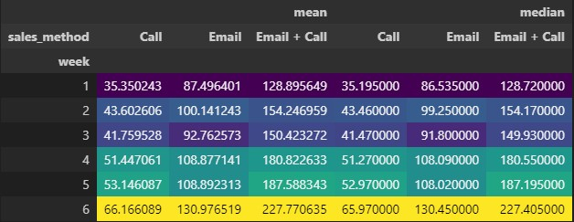
Business Metric to Monitor
Prioritize Performance Metrics: Focus on tracking average weekly revenue generated by each sales method as the primary performance indicator to optimize revenue and profit growth.
Superiority of Email + Call: Data shows that the Email + Call method consistently yields higher average weekly revenues compared to other methods, indicating its effectiveness in boosting sales.
Detailed Revenue Analysis: Weekly average revenues for the Email + Call method range from $128.89 in week 1 to $227.77 in week 6, highlighting its upward revenue trend despite occasional dips.
Continuous Monitoring and Adjustment: Regular analysis of this key metric enables timely strategic adjustments, ensuring sales strategies align with company objectives and market demands.

Slide 11
Final Summary and Conclusion
In the coming weeks, we recommend focusing on several
strategic actions to boost sales:
1. Monitoring Key Metrics
2. Launching a Loyalty Campaign
3. Maintaining Awareness of Marketing Trends
4. Enhancing Data Collection for In-depth Analysis

Slide 12
To conclude, adopting the Email + Call method as a multi-channel approach yields a higher return on time invested and significantly enhances operational efficiency and revenue generation. It is advisable to make follow-up calls a day or two after sending product information emails, as delayed calls often lead to reduced engagement and recall. Prompt follow-ups effectively leverage timing to boost sales conversion rates, positioning the team to excel and outperform the competition with these focused strategies.

